Slide 1
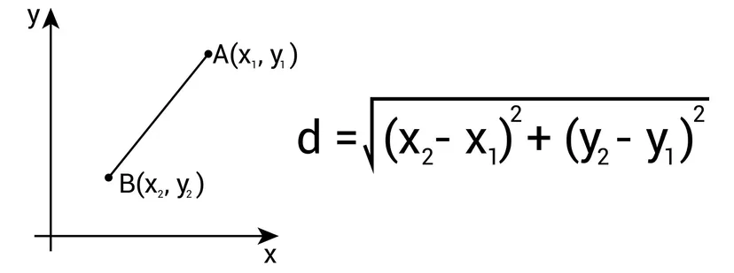
Programming Practice 01
Given two points as tuples, write a function to calculate the distance between the two points.
print(distance((2, 2), (1, 1)))
> 1.4142135623731
NOTE: We can import math and use the math.sqrt() and math.pow() functions!

Slide 2
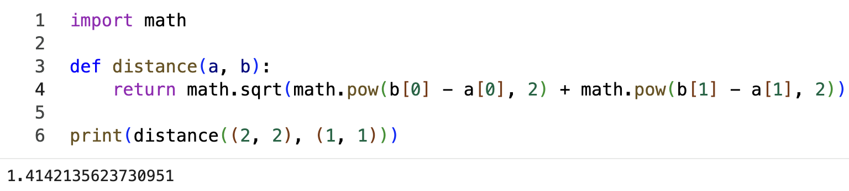
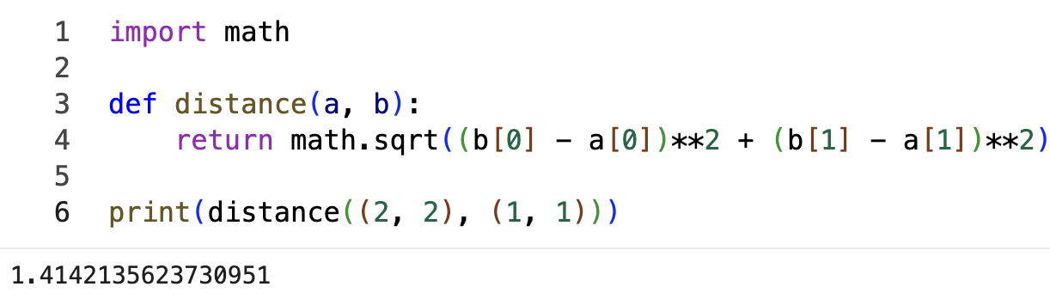
Programming Practice 01 Solution

Slide 3
CSE 10124 Embeddings 01

Slide 4
Homework 02
There was a question last class of whether, with only one lecture on embeddings, would it be doable. I think it should be, but if you have issues or questions on it please ask!
Due to slowing the class down a bit, Homework 03 will also be on embeddings, though taking it a step or two further.

Slide 5
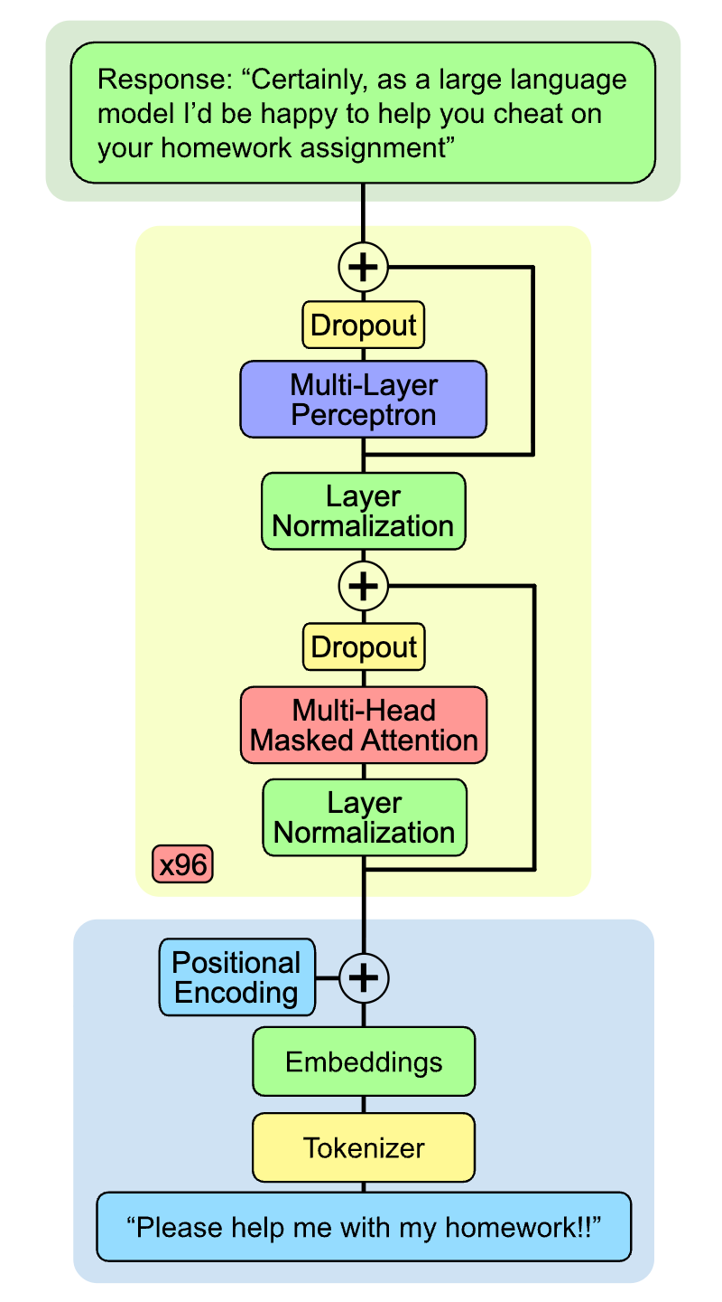
Labs
Lab 01 will be a guided walkthrough of tokenization and programming the RegexTokenizer() class which will be the first piece of code for our LLM we’re building this semester.

Slide 6
Where were we?
In the prior 3 lectures we focused on tokenization, which is the first thing that happens when you type your prompt into an LLM

Slide 7
Where are we?
Today we’re going to start on the step that follows tokenization, which is called embedding.
Understanding the concept of embedding is crucial to understanding deep learning in general.

Slide 8
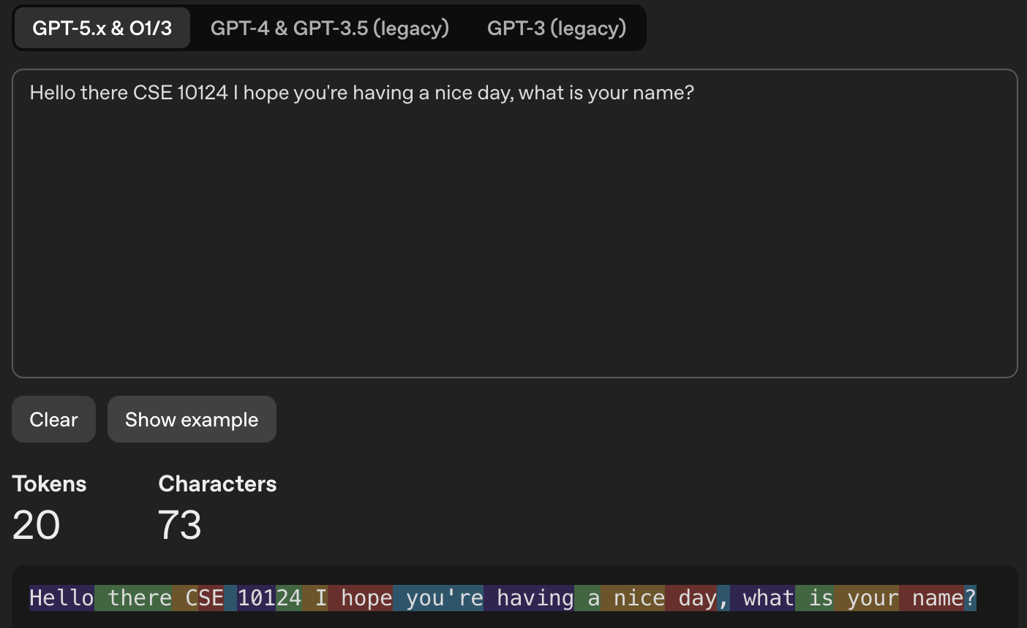
Tokenization
Are we actually gaining anything from this?

Slide 9
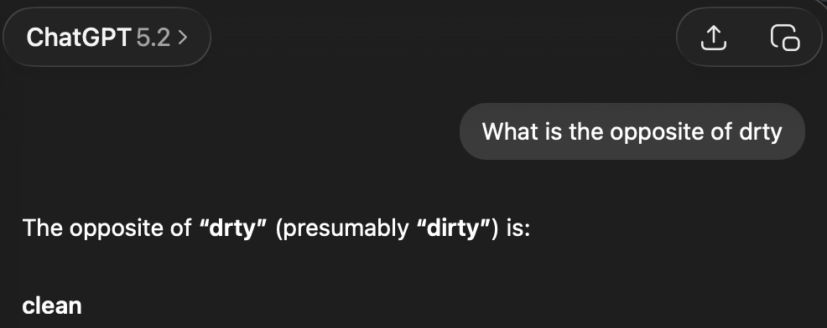
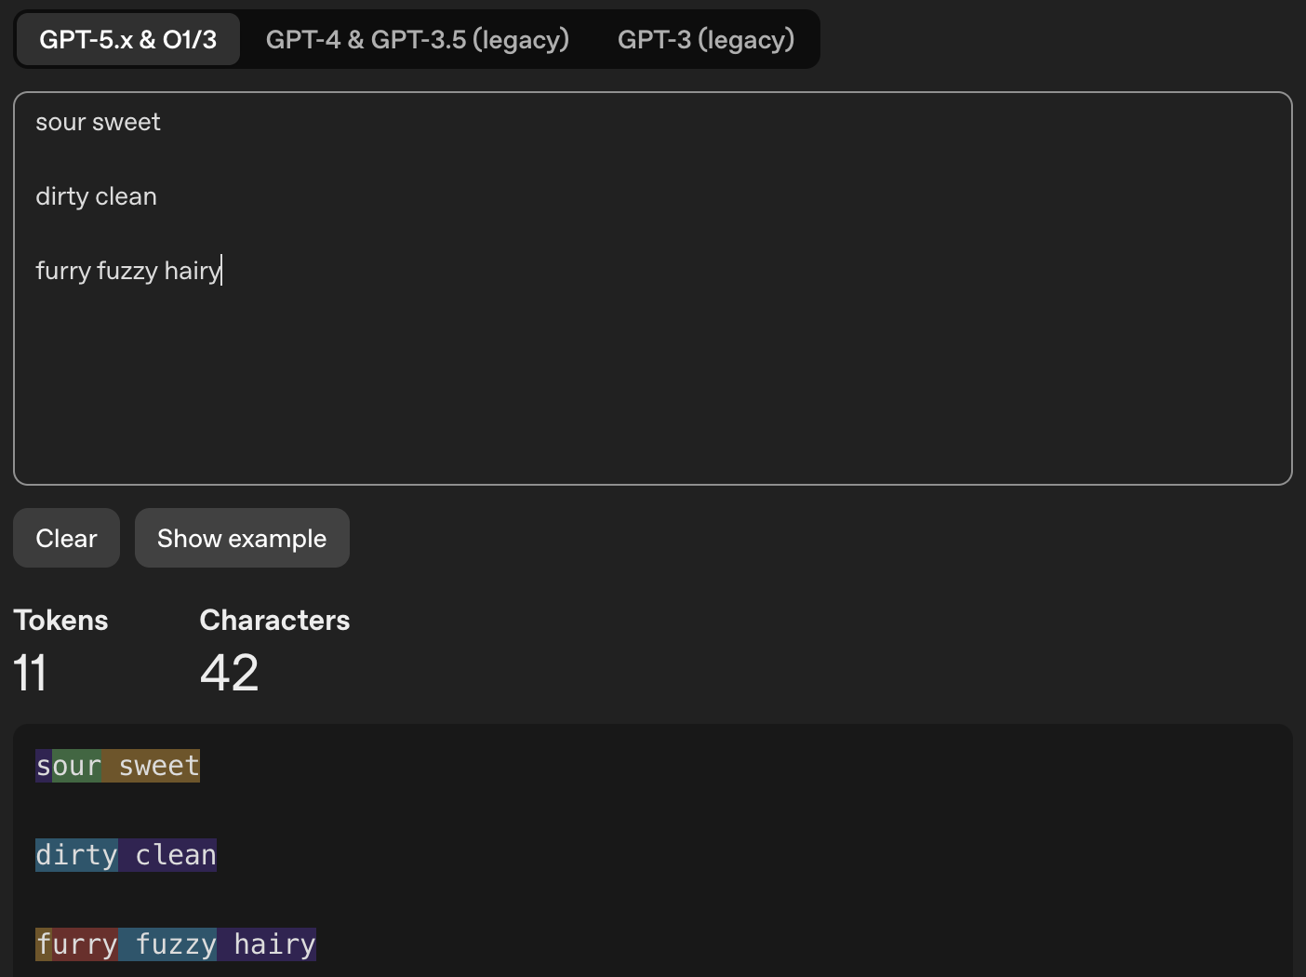
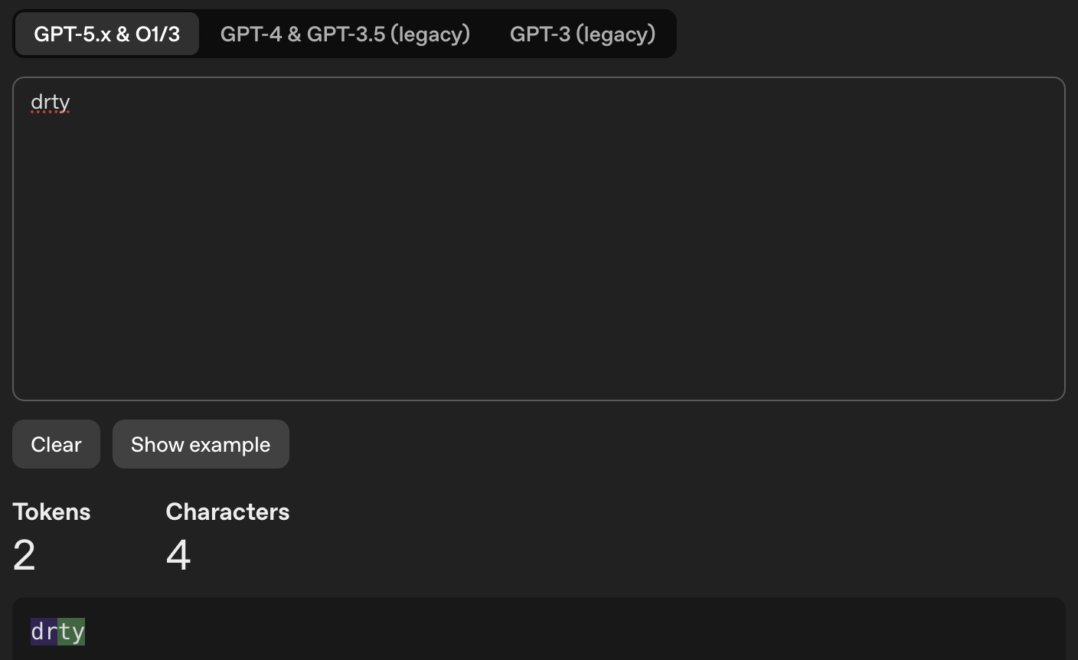
Tokenization

Slide 10
What makes words similar?

Slide 11
GPA Predicting Dataset
Lets design a dataset to predict whether incoming students will graduate or not

Slide 12
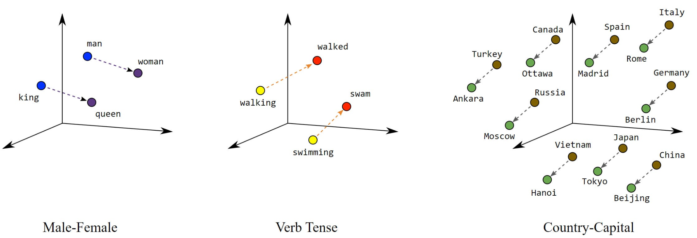
Space - Embeddings

Slide 13
Deep Learning: Dataset
A dataset is a collection of feature vectors for samples that are ideally representative of the population we’re interested in

Slide 14
Deep Learning: features
In deep learning, a feature is a way to describe a sample
A sample is one individual “thing” in our dataset. Maybe a bird, a flower, or a person.

Slide 15
Deep Learning: feature vector
A feature vector then is a representation of a sample in some high-dimensional space

Slide 16
Types of Features: Numeric
Numerical (continuous): Values that can take any number within a range, including decimals. You can always find a value between any two values.
Examples:
Numerical (discrete): Values that are countable whole numbers—you can't have "half" of one. There are gaps between valid values.
Examples:

Slide 17
Dangers of Numeric Variables

Slide 18
Feature Normalization/Scaling

Slide 19
Wait a Second…
We’ve seen the word “normalization” before

Slide 20
Types of Features: Categorical
Categorical (nominal): Categories with no inherent order or ranking—just different labels. Assigning numbers to them would be arbitrary.
Examples:
Categorical (ordinal): Categories that have a meaningful order or ranking, but the "distance" between categories isn't necessarily equal or measurable.
Examples:

Slide 21
Machine Learning: Classification
In machine learning, a classification task is one in which we’re trying to predict a category or label given a sample.
For our student dataset, our categories are: “Will Graduate” and “Will not graduate”

Slide 22
Dangers of Categorical Variables

Slide 23
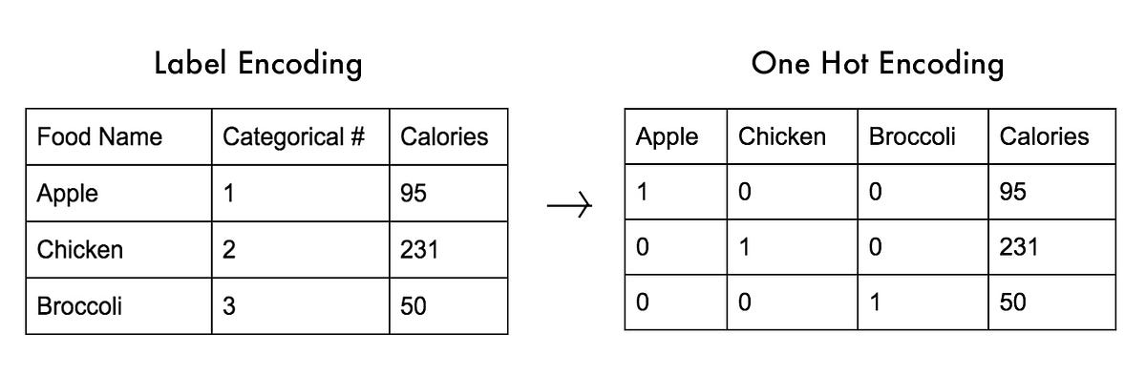
One-Hot Encoding
One-Hot Encoding is the most common way to convert a categorical variable into a numeric one.

Slide 24
One-Hot Encoding in LLMs

Slide 25
Machine Learning: Supervised Learning
We call it supervised learning when we have examples of the correct answer in our dataset, because we can tell our model if it guessed correctly or not. We call these correct answers ground truth

